Slide 1

Original Article A Cluster-Randomized Trial of Blood-Pressure Reduction in Black Barbershops
Ronald G. Victor, M.D., Kathleen Lynch, Pharm.D., Ning Li, Ph.D., Ciantel Blyler, Pharm.D., Eric Muhammad, B.A., Joel Handler, M.D., Jeffrey Brettler, M.D., Mohamad Rashid, M.B., Ch.B., Brent Hsu, B.S., Davontae Foxx-Drew, B.A., Norma Moy, B.A., Anthony E. Reid, M.D., and Robert M. Elashoff, Ph.D.
N Engl J Med
Volume 378(14):1291-1301
April 5, 2018

Slide 2
Study Overview
In this trial involving black male barbershop patrons with uncontrolled hypertension, health promotion by barbers resulted in larger blood-pressure reduction when coupled with medication management in barbershops by specialty-trained pharmacists.

Slide 3
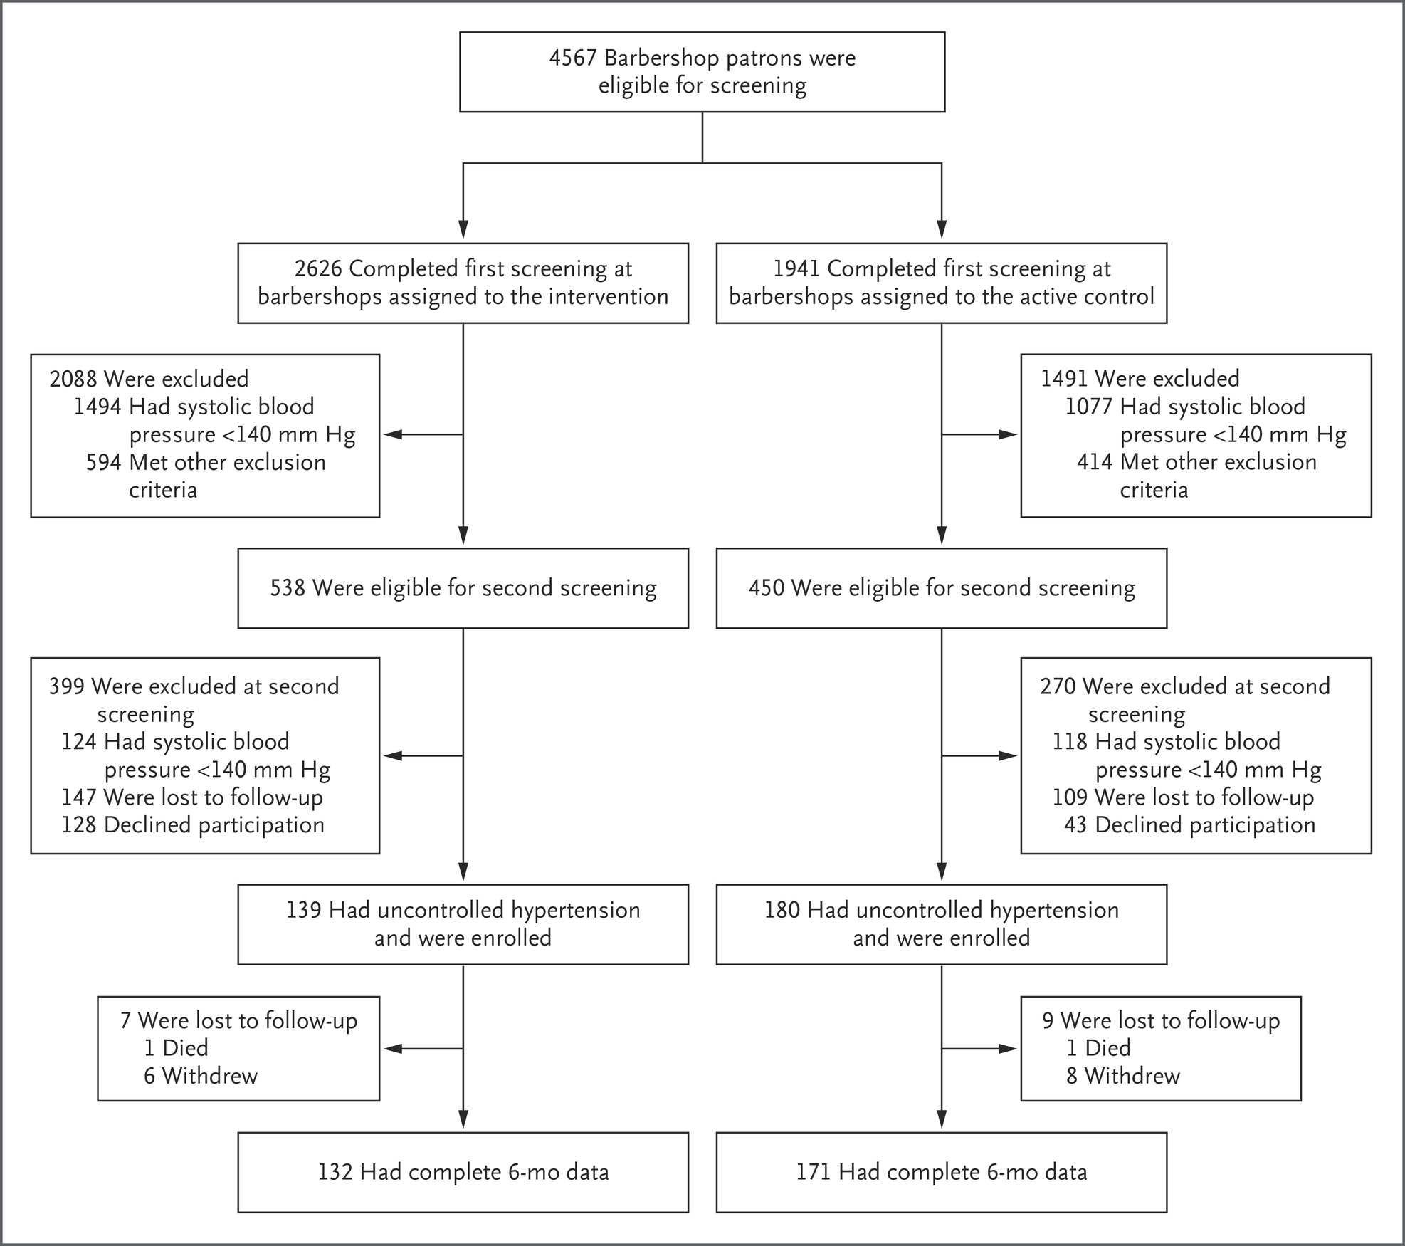
Screening, Enrollment, and Follow-up of Barbershop Patrons.
Victor RG et al. N Engl J Med2018;378:1291-1301
Notes:
Figure 1 Screening, Enrollment, and Follow-up of Barbershop Patrons. Other exclusion criteria included infrequent barbershop patronage (duration of <6 months or more than every 6 weeks between visits), an age younger than 35 years or older than 79 years, current treatment with dialysis or cancer chemotherapy, or plans to relocate.

Slide 4
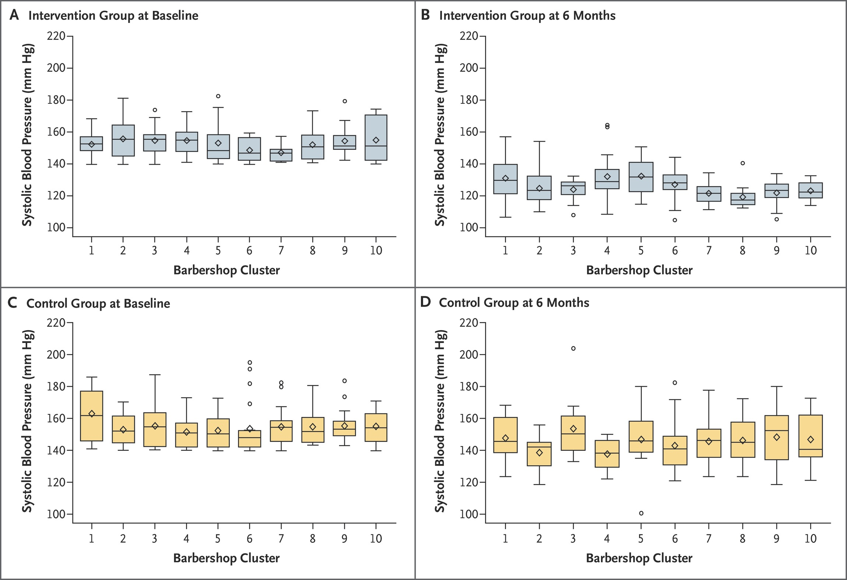
Systolic Blood Pressure at Baseline and 6 Months According to Barbershop Cluster.
Victor RG et al. N Engl J Med2018;378:1291-1301
Notes:
Figure 2 Systolic Blood Pressure at Baseline and 6 Months According to Barbershop Cluster. Shown are box plots for systolic blood pressure according to barbershop cluster. The horizontal line inside each box indicates the median, the diamond indicates the mean, and the bottom and top of each box indicate the 25th percentile and 75th percentile, respectively. 𝙸 bars indicate the upper adjacent value (75th percentile plus 1.5 times the interquartile range) and the lower adjacent value (25th percentile minus 1.5 times the interquartile range), and the circles outliers.

Slide 5
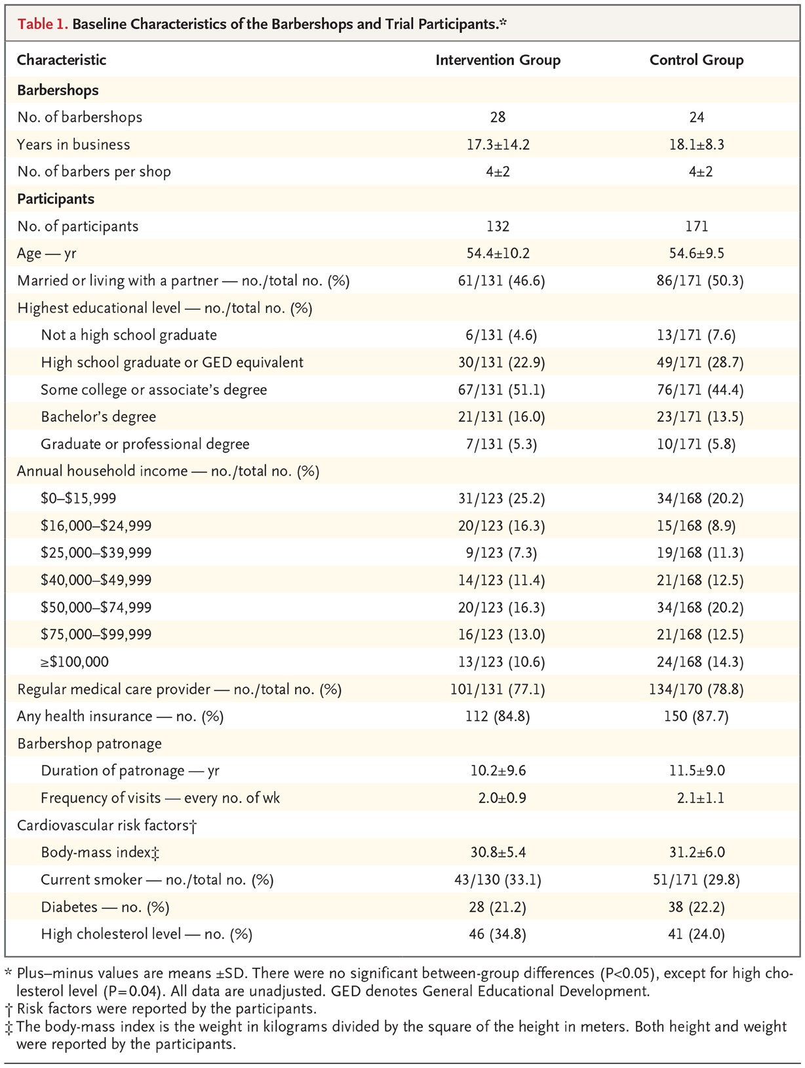
Baseline Characteristics of the Barbershops and Trial Participants.
Victor RG et al. N Engl J Med2018;378:1291-1301
Notes:
Table 1 Baseline Characteristics of the Barbershops and Trial Participants.

Slide 6
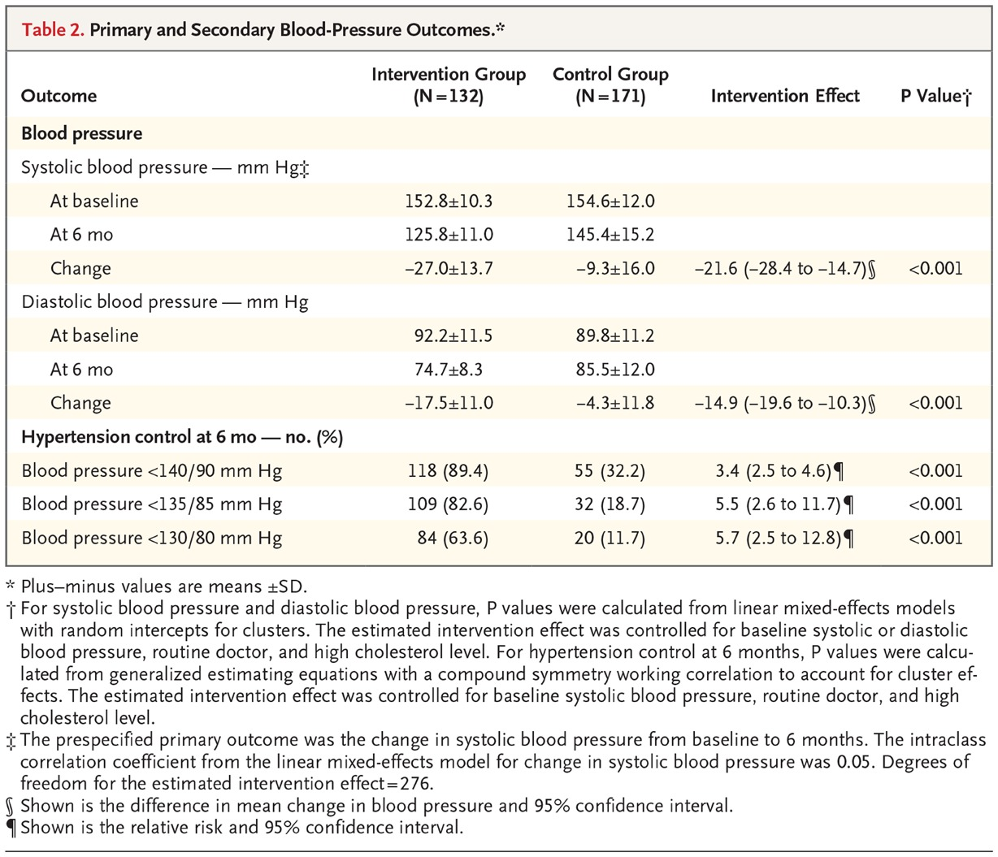
Primary and Secondary Blood-Pressure Outcomes.
Victor RG et al. N Engl J Med2018;378:1291-1301
Notes:
Table 2 Primary and Secondary Blood-Pressure Outcomes.

Slide 7
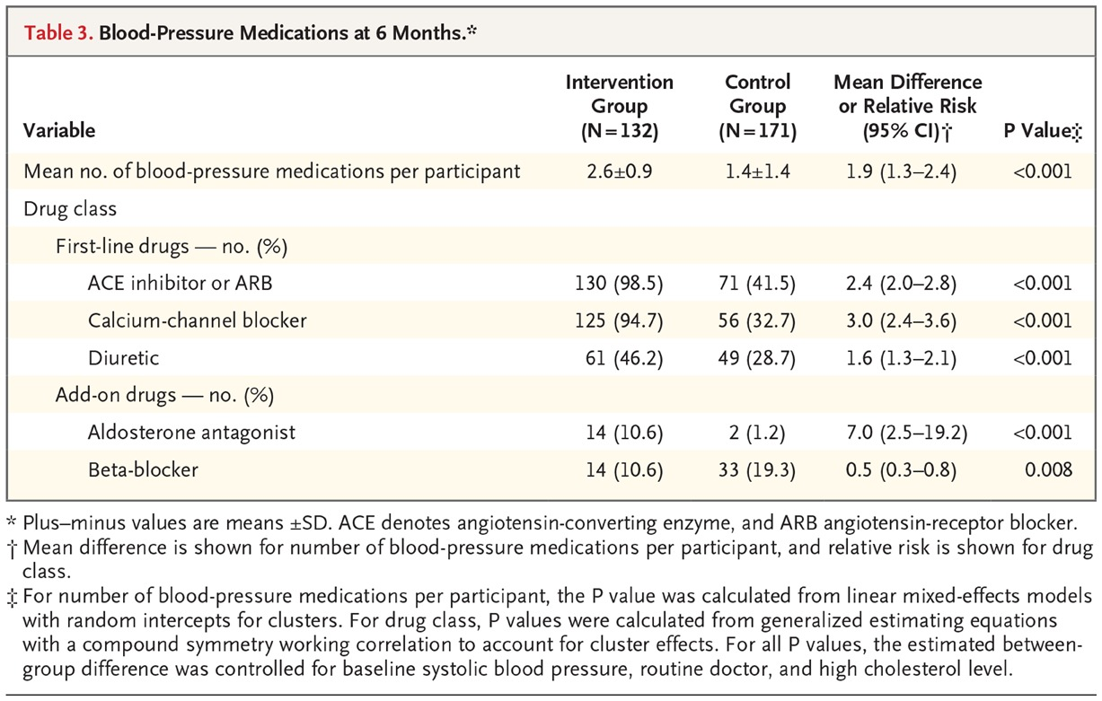
Blood-Pressure Medications at 6 Months.
Victor RG et al. N Engl J Med2018;378:1291-1301
Notes:
Table 3 Blood-Pressure Medications at 6 Months.

Slide 8
Conclusions
Among black male barbershop patrons with uncontrolled hypertension, health promotion by barbers resulted in larger blood-pressure reduction when coupled with medication management in barbershops by specialty-trained pharmacists.

